Slide 1

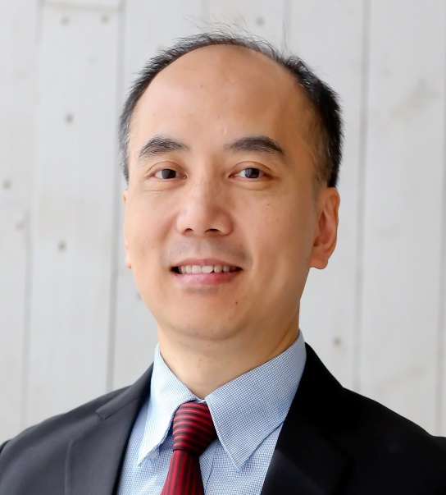

有效建立購物年金
Build Your Shopping Annuity
YK Tam
高級顧問經理級
Director
四個佣金週期共賺取HK$138,000
HK$138,000 in 4 Commission weeks
本簡報中提到的收入等級純屬舉例說明，無意代表美安香港超連鎖™店主的一般收入，也無意表示任何超連鎖™店主皆可賺取同等收入。美安香港超連鎖™店主的成功與否，取決於其在發展事業時的努力、才能與投入程度。
The income levels mentioned in the following presentation are for illustration purposes only. They are not intended to represent the income of a typical Market Hong Kong UnFranchise ™Owner, nor are they intended to represent that any given Independent UnFranchise ™ Owner will earn income in that amount. The success of any Market Hong Kong Independent UnFranchise ™ Owner will depend upon the amount of hard work, talent, and dedication which he or she devotes to building his or her Market Hong Kong Business.

Slide 2

Shopping Annuity
Change people's shopping pattern, convert spending into earning with MPCP and earn ongoing income.
You already spending it. We group the power of spending through SHOP.COM and create a new economic pattern. Average people are able to obtain financial freedom which is going to change this world.

Slide 3
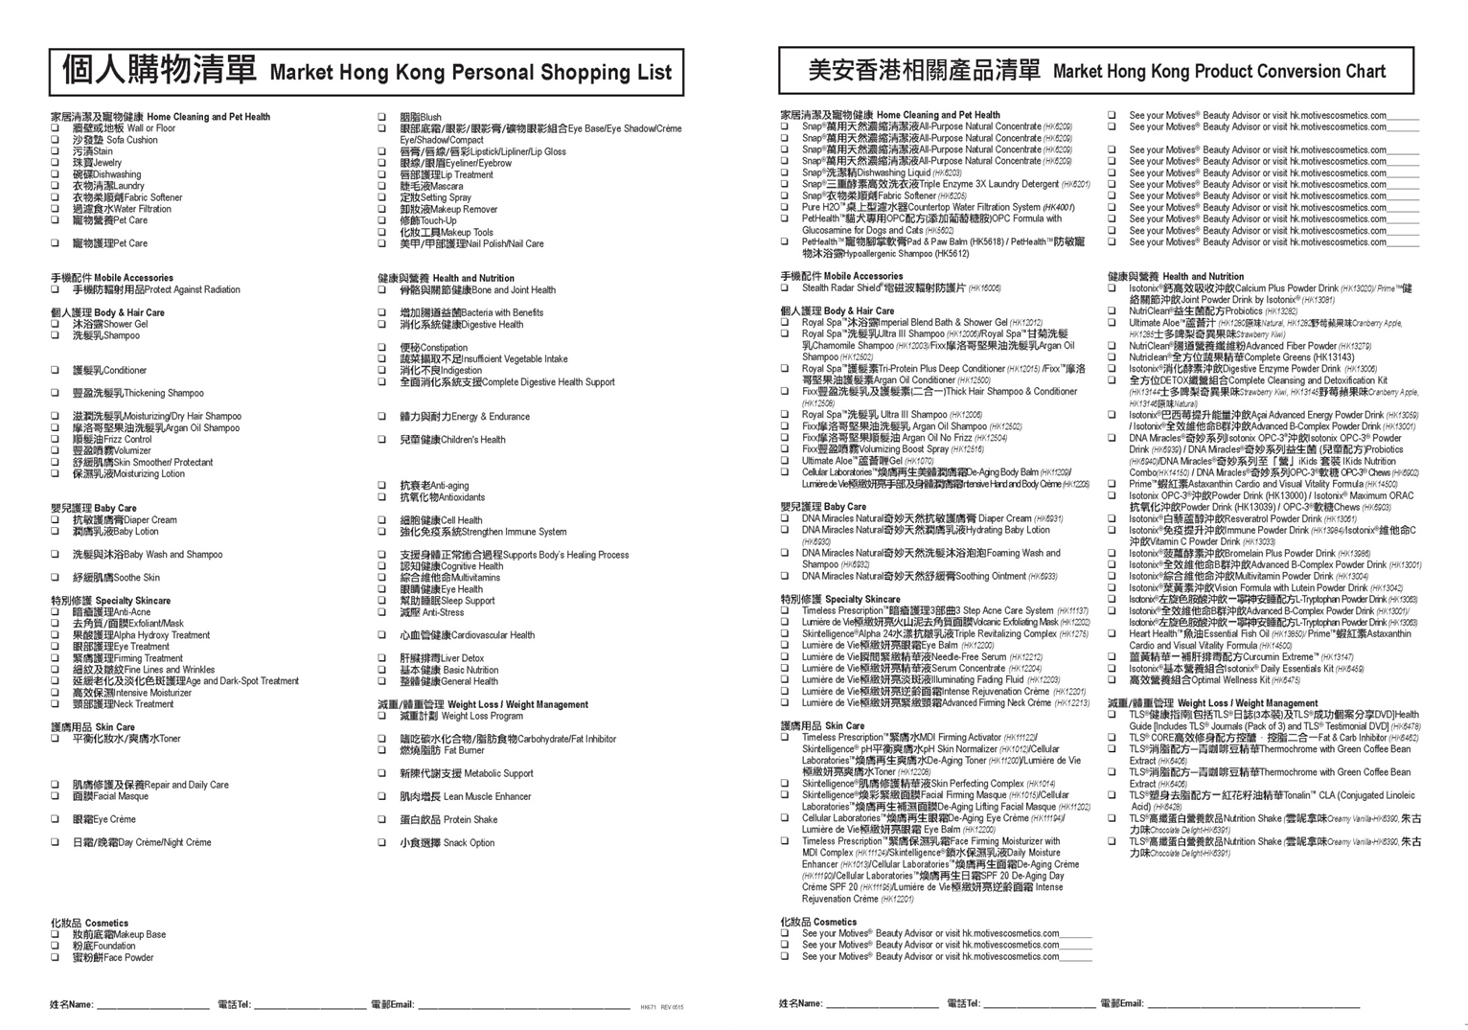
Shopping Annuity
When to start changing?

Slide 4
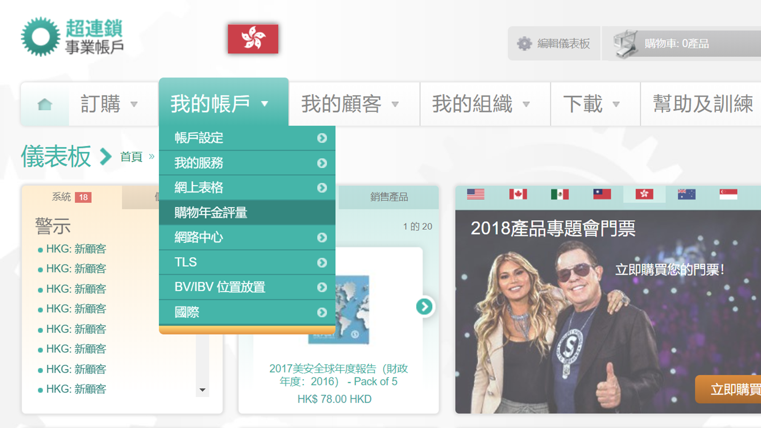
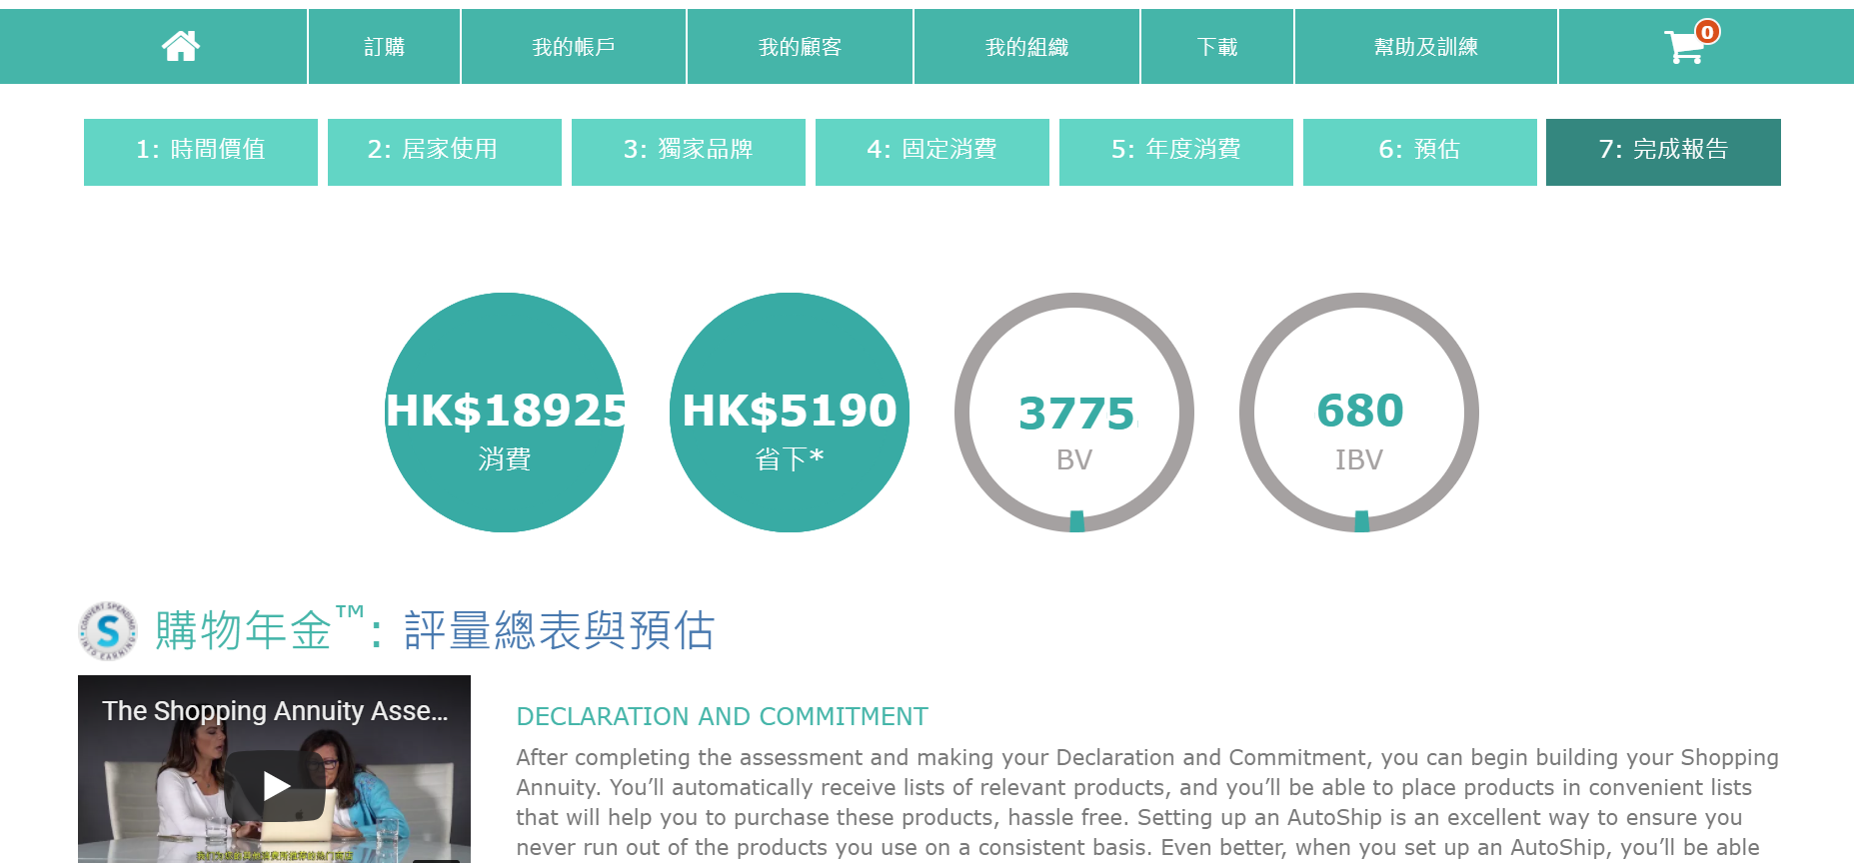
Shopping Annuity
When to start changing?
  Personal Shopping List
  Try and replace the original daily commodities bit by bit
  Through product training, workshops, product symposium etc (build up values)
  Shopping Annuity Assessment (preview the target that you can meet)

Slide 5

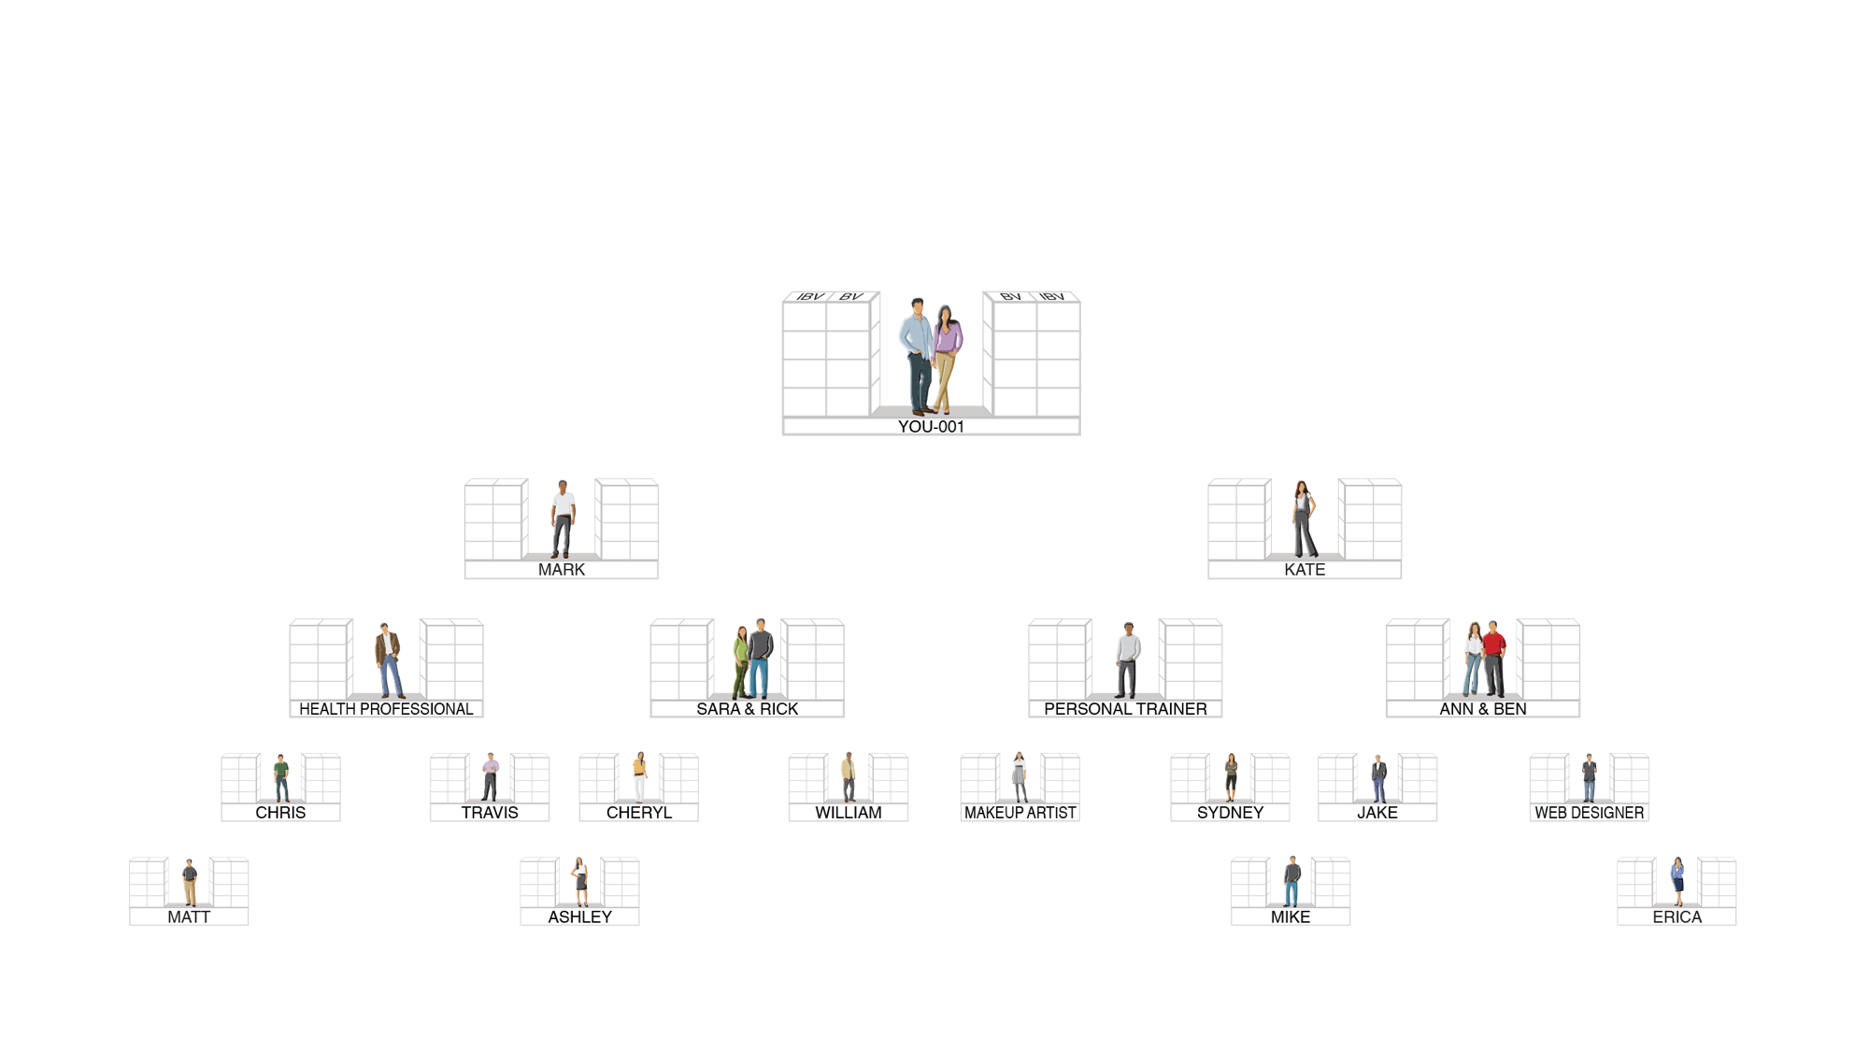
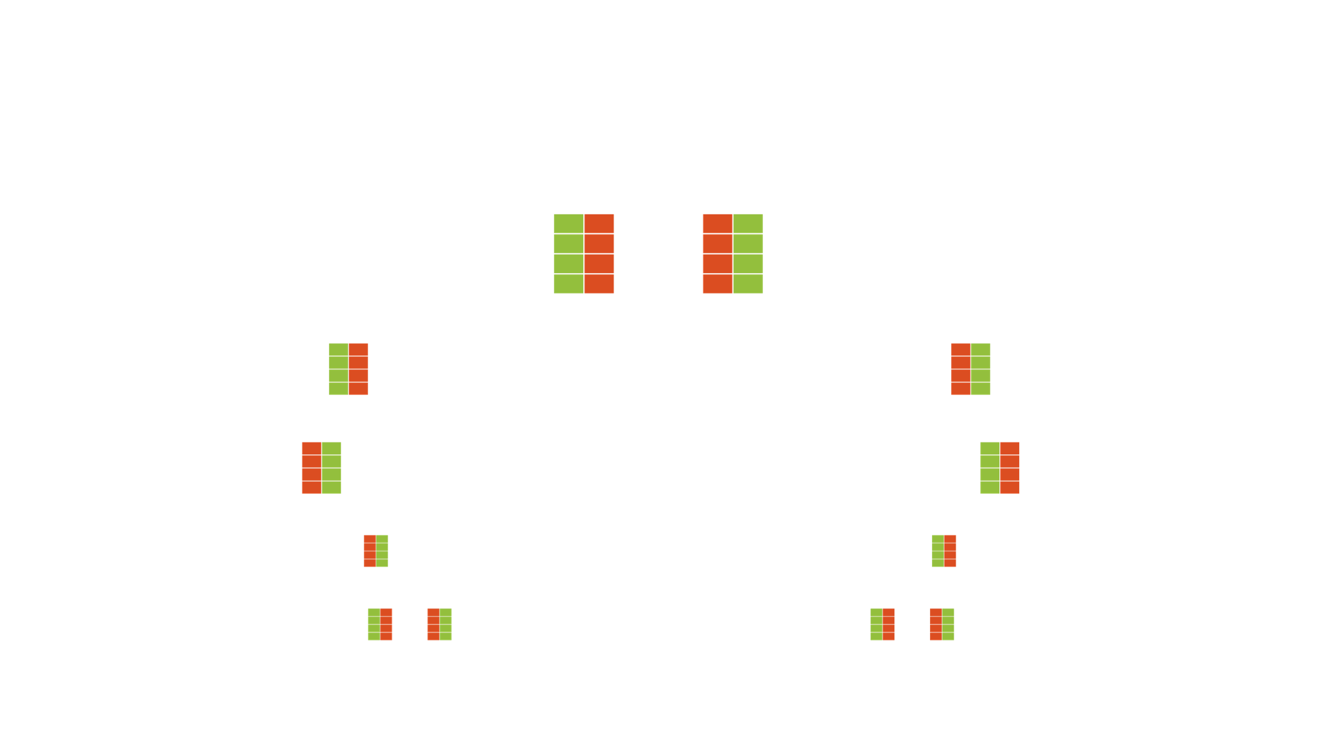

MHK TRACKING SYSTEM SEARCHES DAILY TO INFINITY -- MPCP
THE SYSTEM TRACKS PURCHASES AND SALES MADE BY YOU, YOUR CUSTOMERS AND YOUR TEAM.
YOU RECEIVE 100% CREDIT FOR ALL VOLUME GENERATED WITHIN YOUR ORGANIZATION
Health Professional
Personal Trainer
Beauty Artist
Website Designer

Slide 6
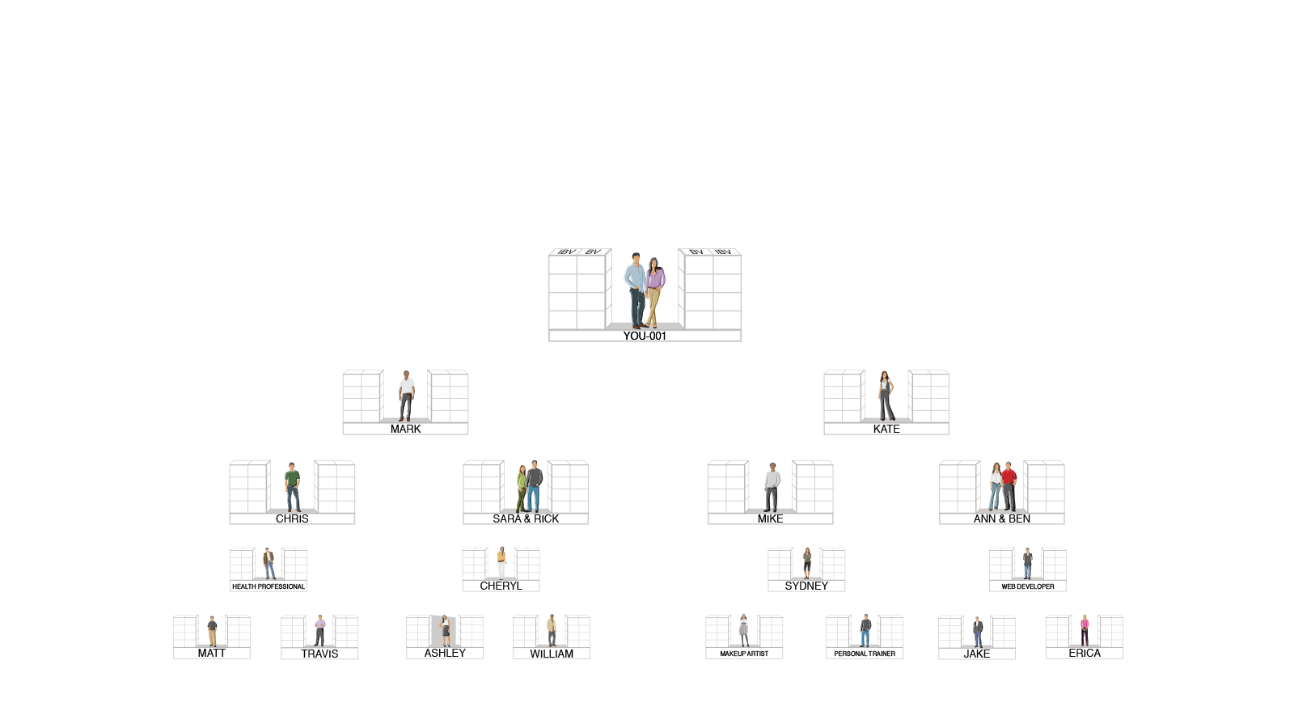
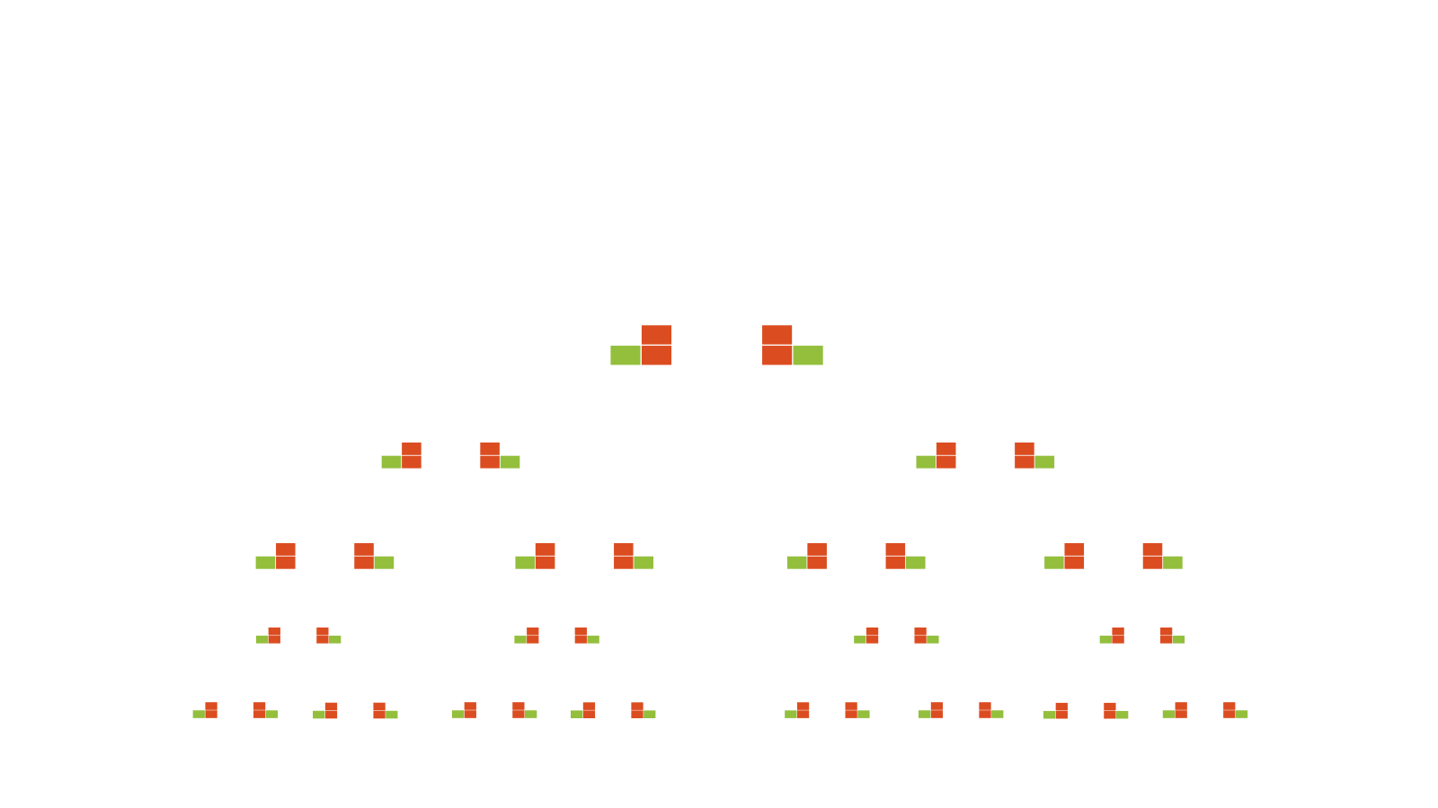
Team only satisfies basic business requirement
receive $4600 /month (BV) & $2300 /quarter (IBV)
50 x 50 BV = 2,500 BV
50 x 10 IBV = 500 IBV
50 x 50 BV = 2,500 BV
50 x 10 IBV = 500 IBV

Slide 7






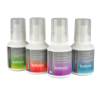




Build up Shopping Annuity with the team
It is faster to earn ongoing income!

Slide 8
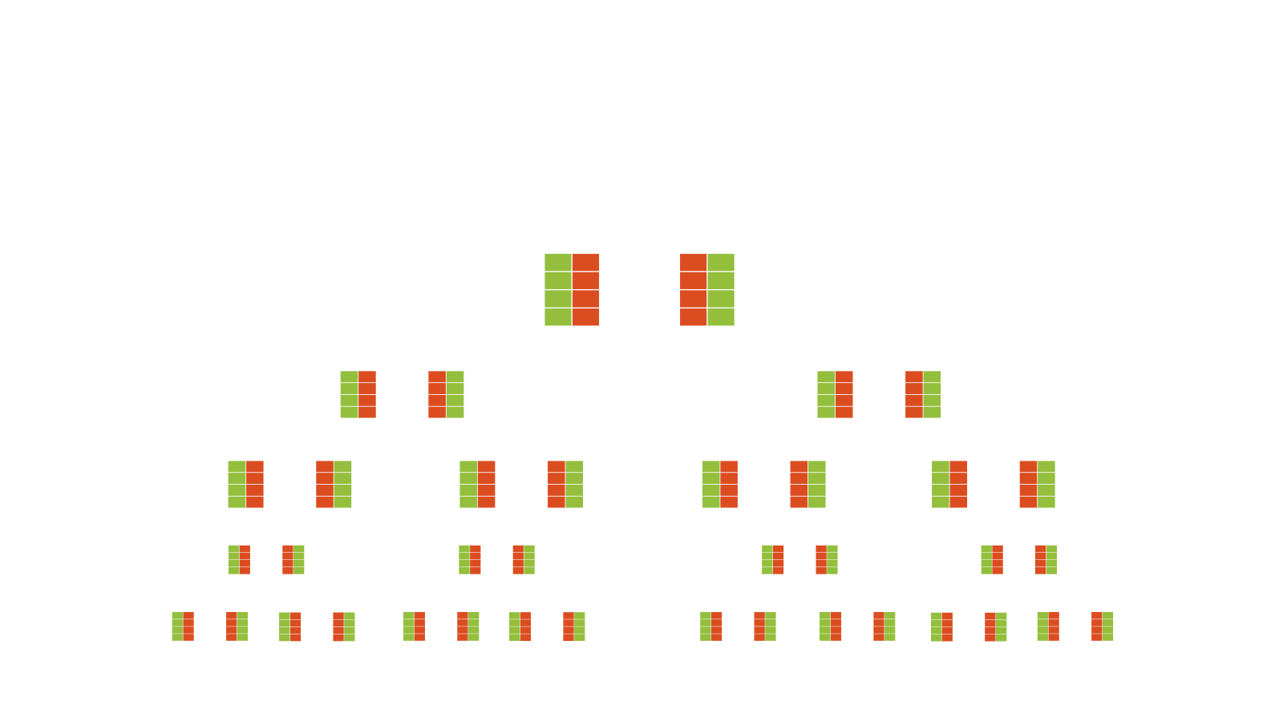
Build up Shopping Annuity with the team
$46,000 / month (BV) & $23,000 /month (IBV)
Same team and
numbers of people!!
50 x 500 BV = 25,000 BV
50 x 200 IBV = 10,000 IBV
50 x 500 BV = 25,000 BV
50 x 200 IBV = 10,000 IBV

Slide 9
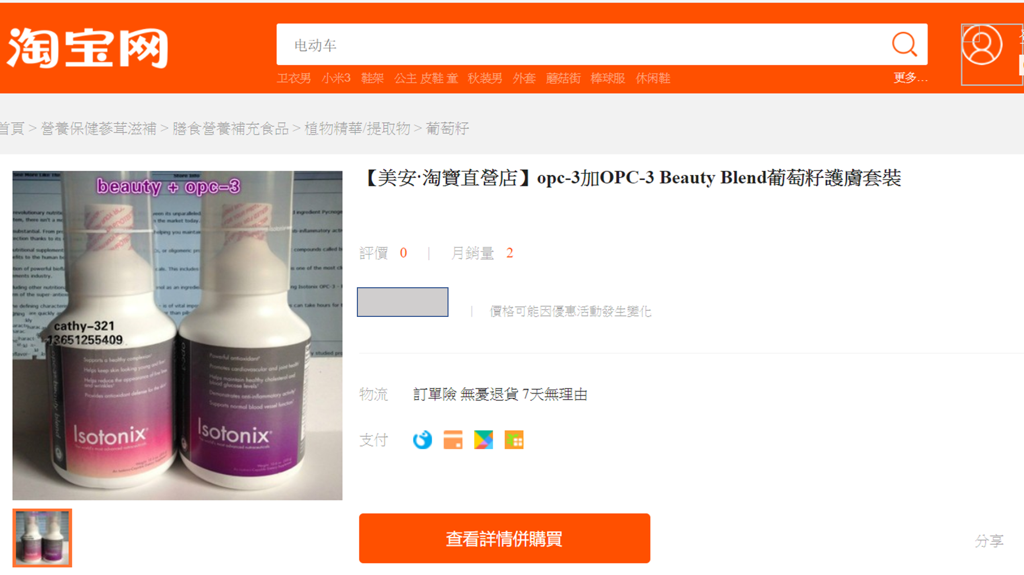
Compliance violation - Online selling!!!

Slide 10

Differences between Linear income & Residual income
Trade personal retail to money
Earn from group spending
Linear income growth
Exponential income growth
Stop working, income stops.
Change consumption habits→Ongoing income
Wage Income
Actual asset income
No time freedom
Time freedom
Make a living, feel insecure
Create your own lifestyle

Slide 11
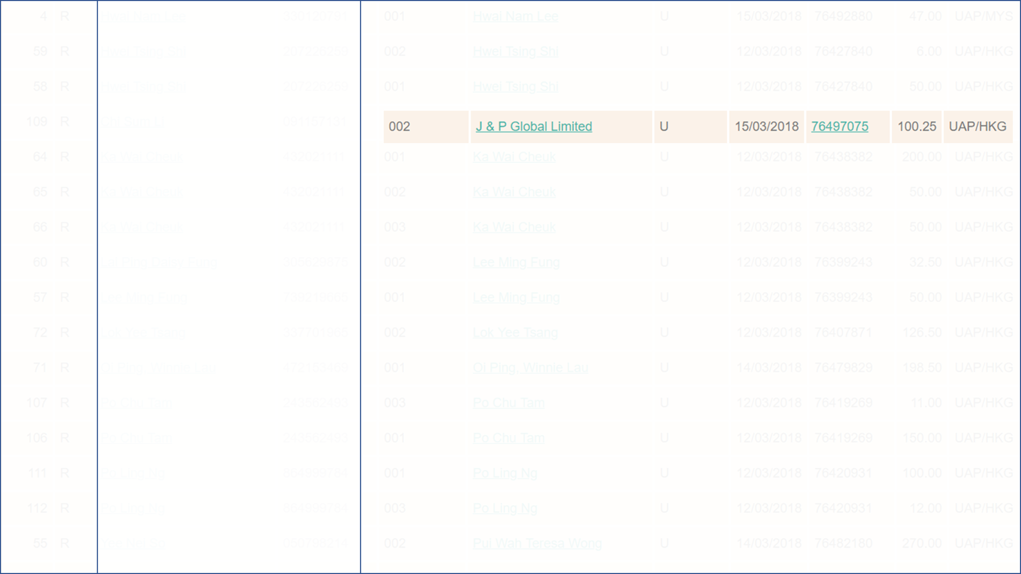
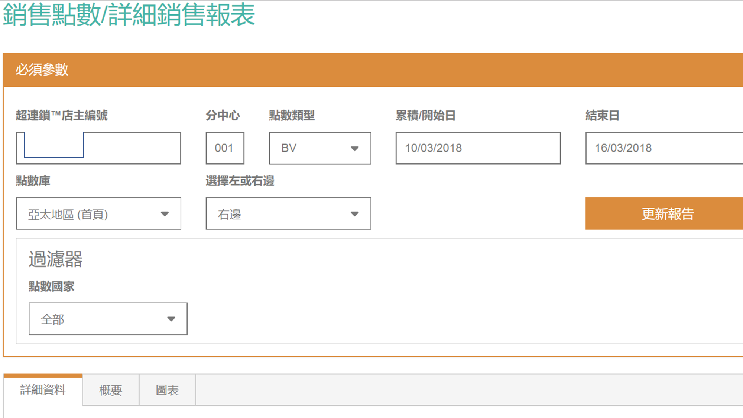
It’s hard to
change consumption habit.
We wait for SO long!

Slide 12

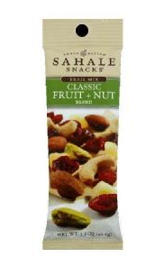
Price
$15.67
Nuts
Sahale Trail Mix, 1.5 oz. (Pack of 9)
BV
3.16

Slide 13

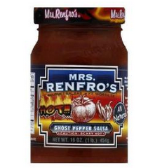
Price
$21.63
Ketchup
Mrs. Renfro's Salsa
16 oz. (Pack of 6)
BV
4.32

Slide 14
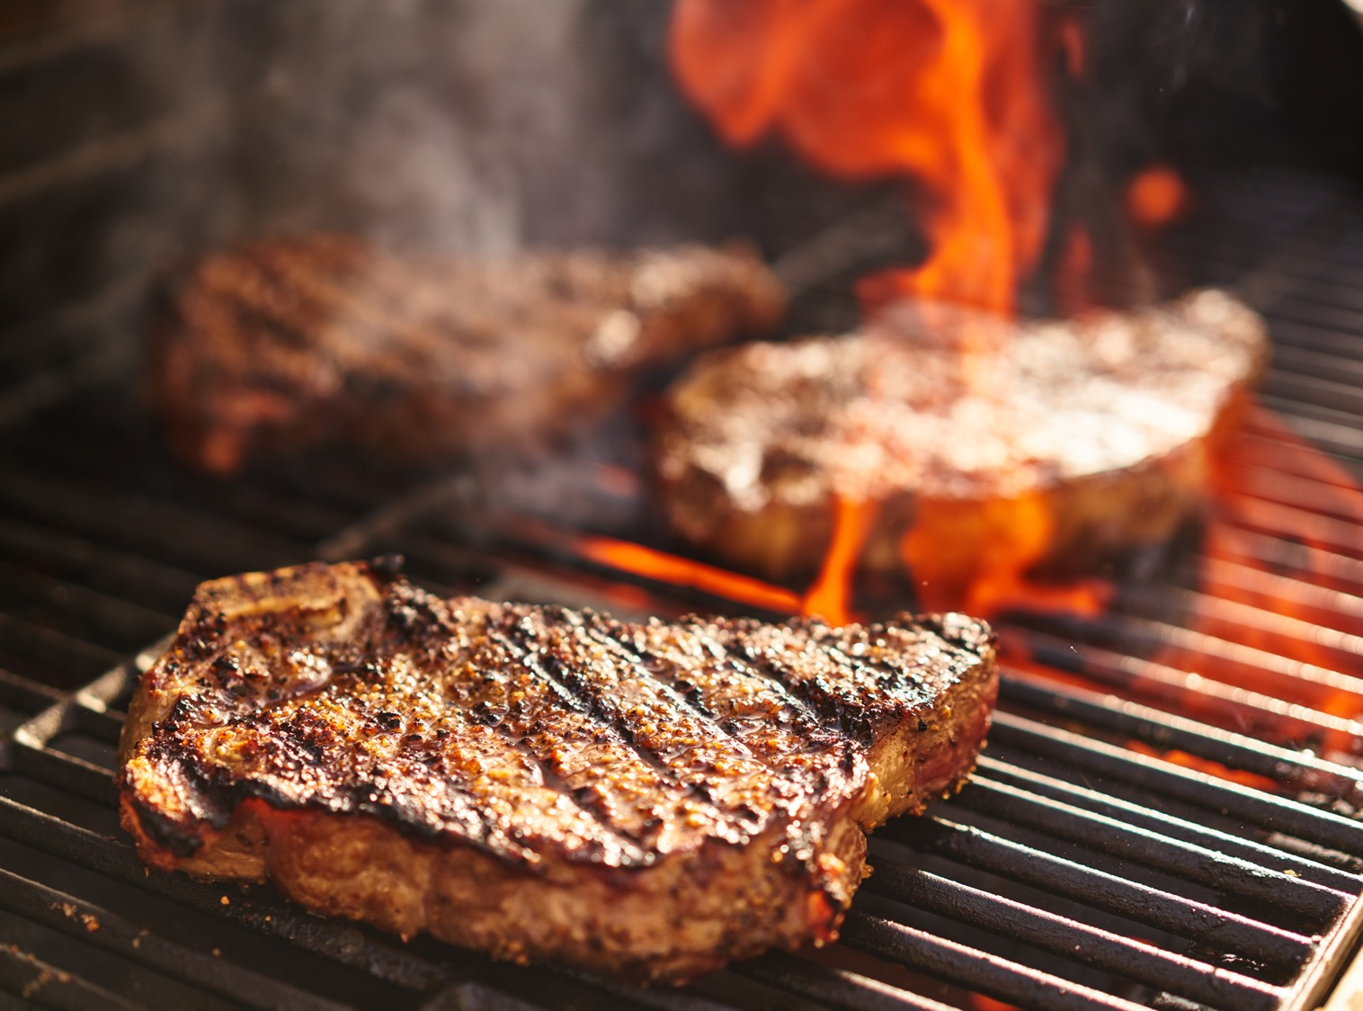
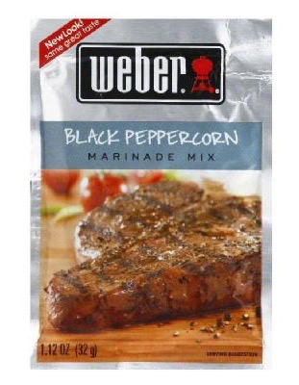
Price
$12.80
Wind dried food
Weber Marinade Mix,
1.12 oz. (Pack of 12)
BV
2.56

Slide 15

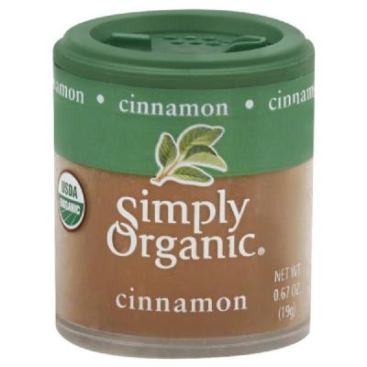
Price
$11.90
Organic Cinnamon
Simply Organic Cinnamon,
0.67 oz. (Pack of 6)
BV
2.40

Slide 16

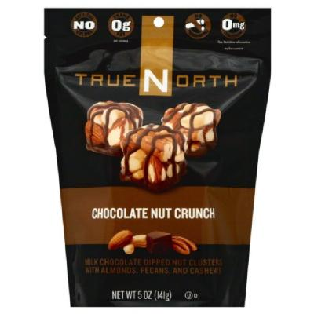
Price
$25.11
Chocolate nuts
TrueNorth Chocolate Nut Crunch, 5 oz.
BV
5.02

Slide 17

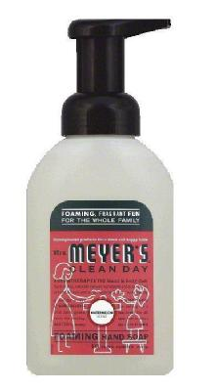
Price
$4.68
Hand soap
Mrs. Meyers Hand Soap, 10 oz.
BV
0.94

Slide 18
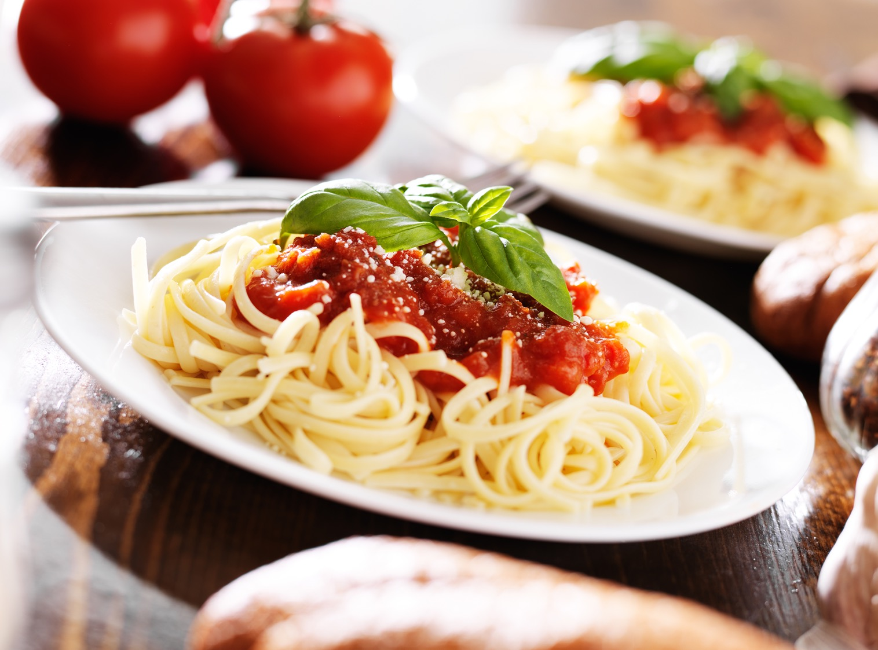
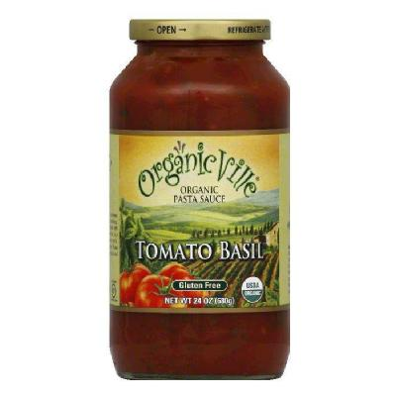
Price
$28.67
Organic Pasta Saurce
Organic Ville Pasta Sauce, 25 oz. (Pack of 6)
BV
5.73

Slide 19

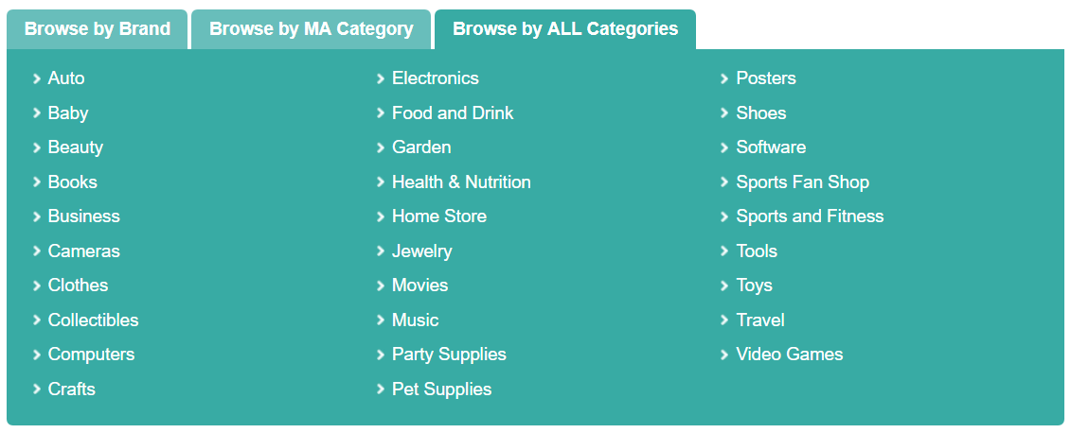


Slide 20
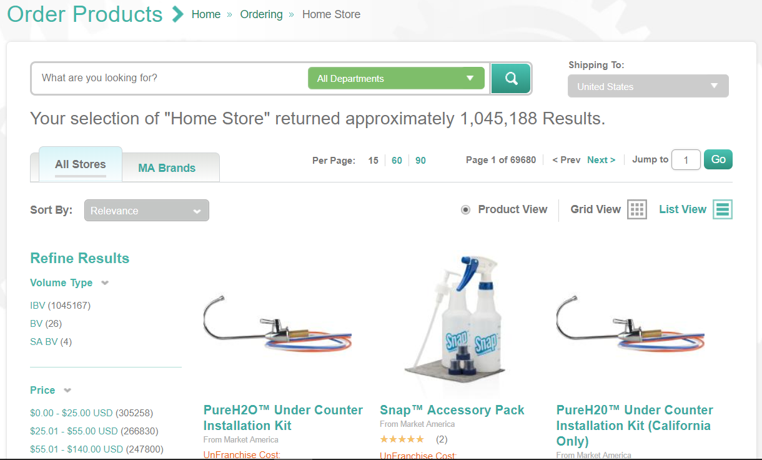

Slide 21

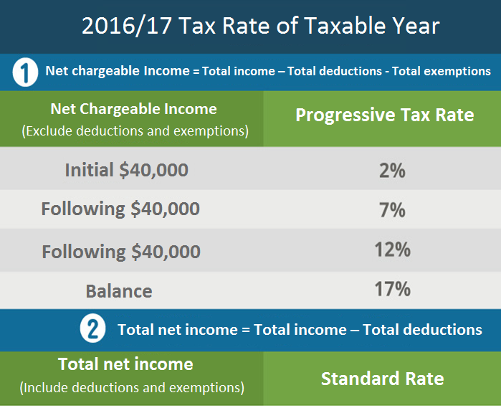

Income and Family
Expenditure Statistics
Average income per family per month:
$30,000
Average spending per family per month:
$27,627
Census and Statistics Department, HKSAR
Notes:
Population and household statistics
http://www.statistics.gov.hk/pub/B10600082015XXXXB0100.pdf
Family expenditure survey
http://www.statistics.gov.hk/pub/B11303012015AN15B0100.pdf

Slide 22


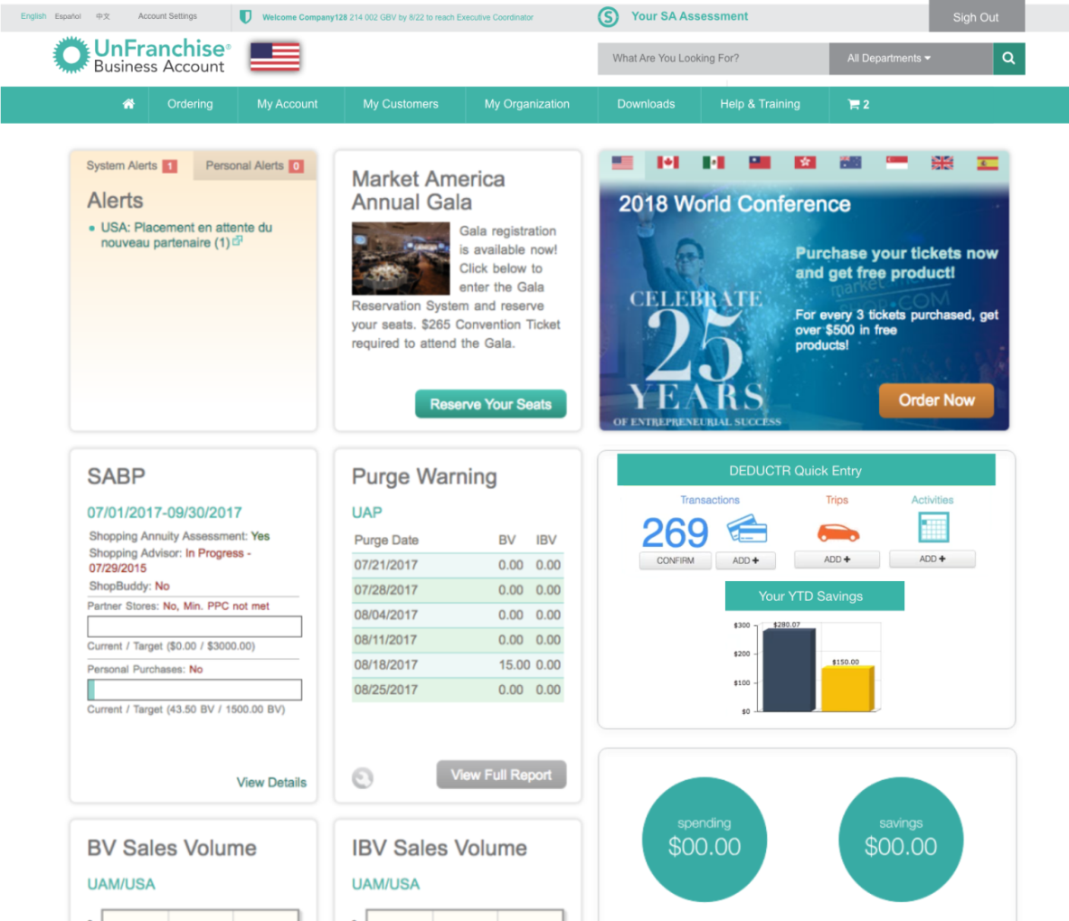
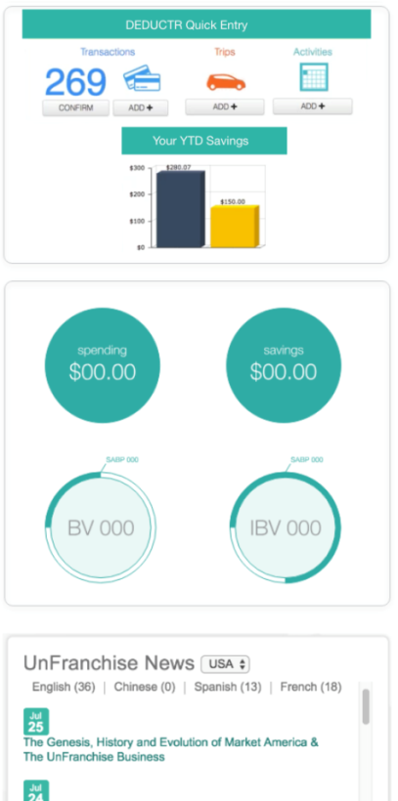
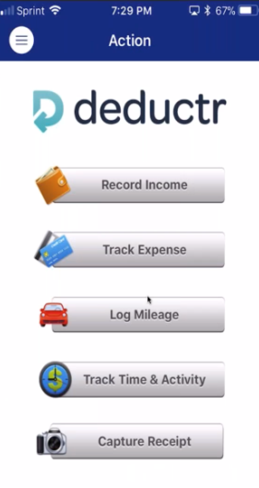
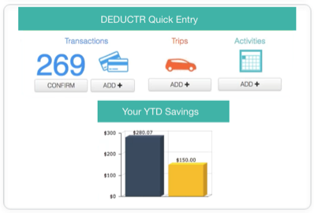
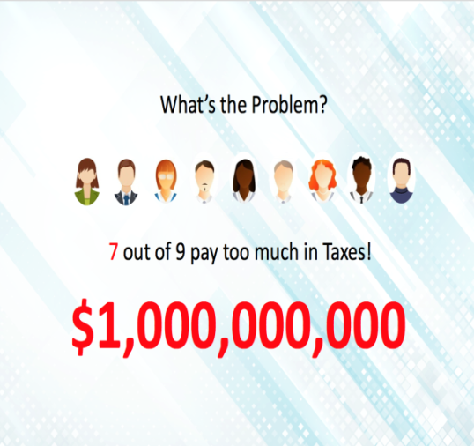
Notes:
登入UnFranchise.com，你就可以管理你的存款及消費以建立購物年金。

Slide 23

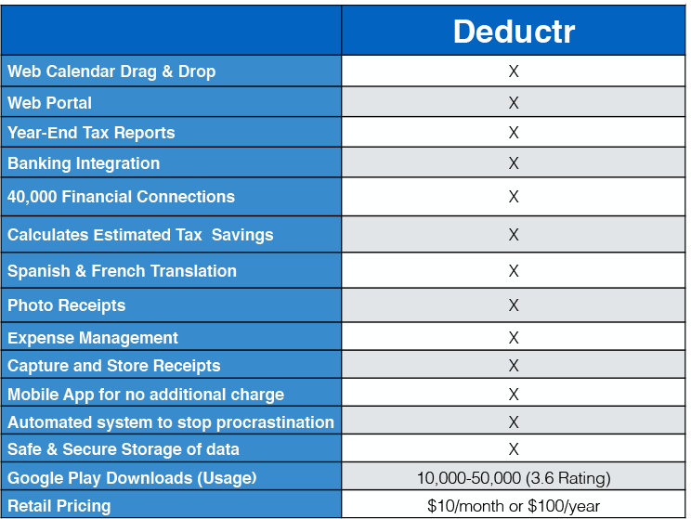

Slide 25
Traditional consumption vs Shopping Annuity consumption
 | Traditional consumption | Shopping AnnuityConsumption
Goal | Search -- Good deal, good quality (Usually you can only have one of two) | All expenses via shop.com (Getting better deal, better quality)
Return | Discount, Reward points or Cashback etc (never be more than you spend) | Privilege such as Cashback + IBV&BV (Under MPCP you may earn residual income that is more than your expenses)
Extra benefit | NO | Tax deductibility is also availablefor some of your expenses. (Earn income via Shopping Annuity and generate related expenses) *depends on the tax system of individual countries
Result | Save money | Save money + Earn money + Tax deduction

Slide 26

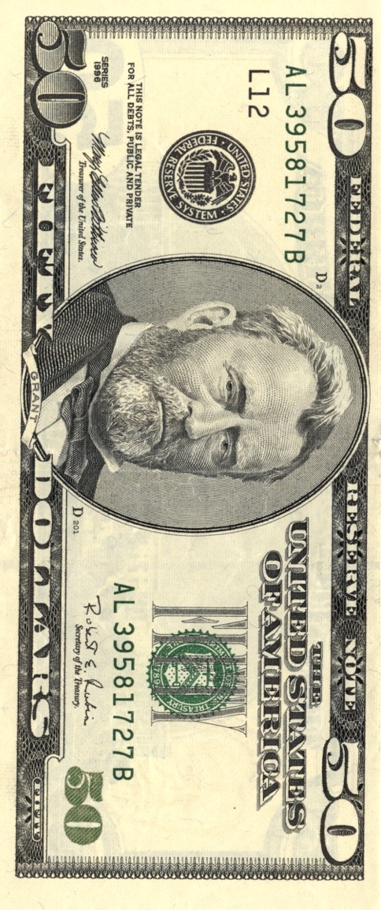
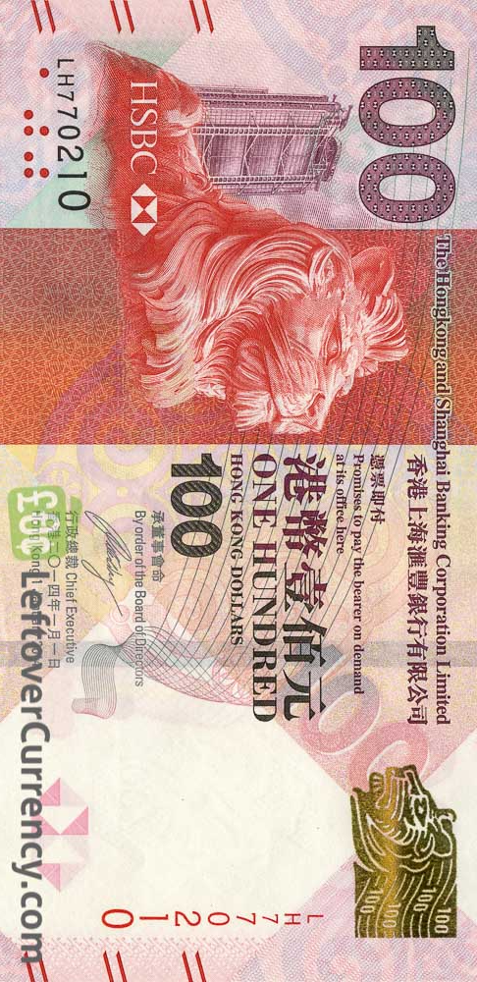
Personal Care and Service
Miscellaneous Expenses
GMTSS
Entertainment
Reading
Health
Food
Transportation
Housing
Fashion and Service

Slide 27

Personal Care and Service
Miscellaneous Expenses
Entertainment
Reading
Health
Food
Transportation
Housing
Fashion and Service

Slide 28

Personal Care and Service
Miscellaneous Expenses
Entertainment
Reading
Health
Food
Transportation
Housing
Fashion and Service

Slide 29
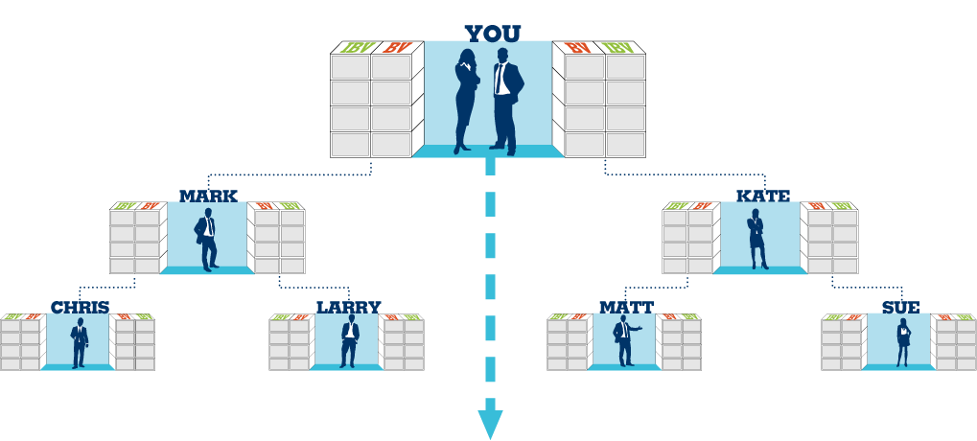
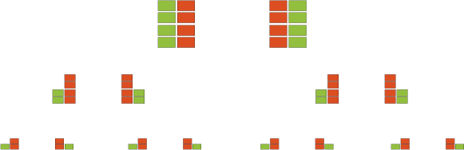
Generate Shopping Annuity
– 7 Strong (SAMM with faith)
Commission = HK$46,000 per year (BV) & HK$16,100 per year(IBV)
Each UnFranchise Owner generate 500 BV + 200 IBV per month
Annual: 7x12x500 BV + 7x12x200 IBV
(42000 BV-12x150 BV) / both sides = 20100 BV /one side = 4 x HK$11500
(16800 IBV-12x30 IBV) / both sides = 8220 IBV /one side = HK$(11500 + 4600)
Annual income:
HK$62,100

Slide 30
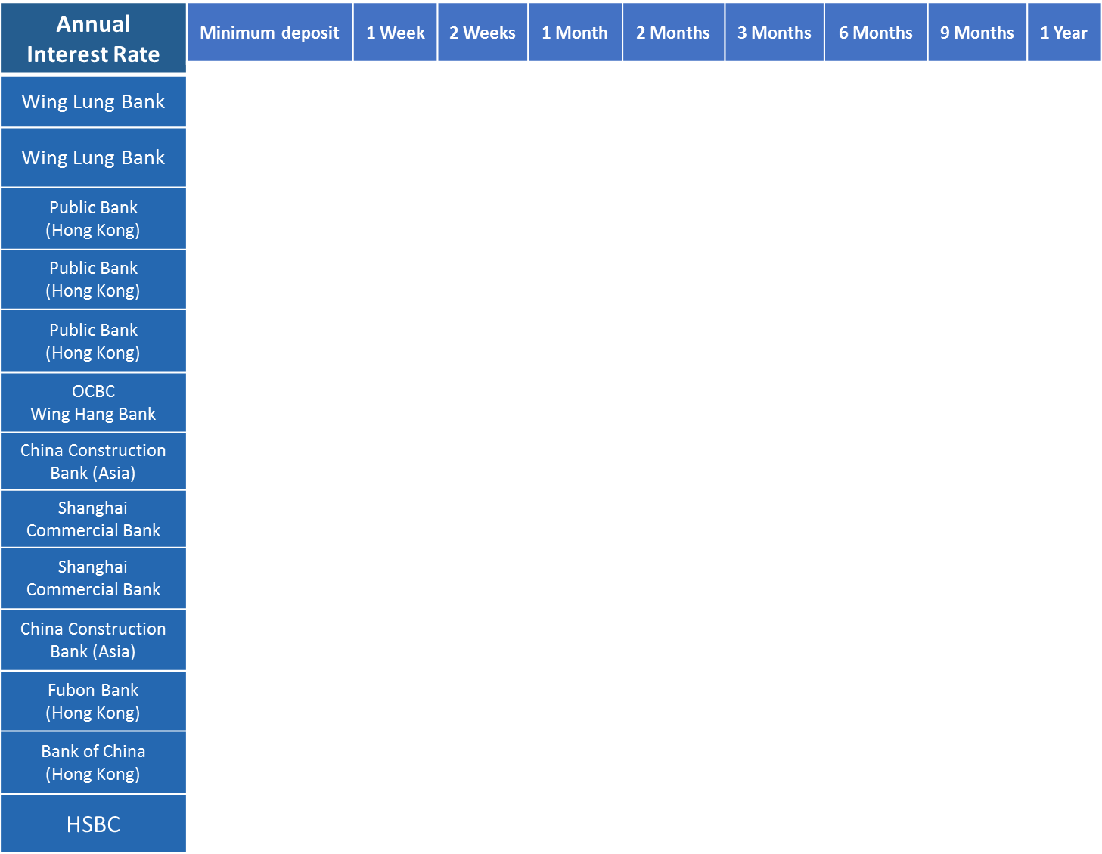
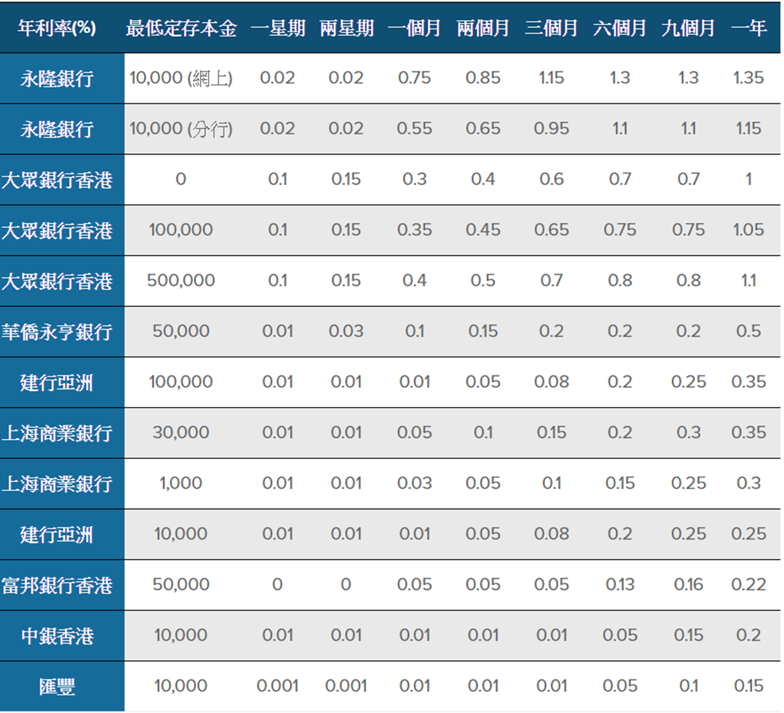
Annual interest: HK$62,100 (value of retail/consumption)
Capital stock: HK$4,600,000 (value of shopping annuity)

